Slide 1

Chapter Program Ideas
Notes:
It is good to test your PowerPoint with the projector you will actually use before you present. Sometimes the slides look good on the computer but look much different on a large screen once combined with a projector. The preview may be a cause to change the slide design to make the text easier to read. It is desirable to have this slide on before the meeting starts to alert people to whether they are in the correct location. It is good to edit this slide to have the correct Region, month, year and location. You are welcome to customize the slide design to your taste.
Click to add contact information.

Slide 2
Monthly Program Topics and Formats
Technical Talks & DL Program
Panels or forums
Technical tours/field trips
Technical/research talks
Student/YEA/Membership Promotion
Chapter seminars/shows
Non-technical talk
Joint meetings
Community service activities
Don’t forget the R in ASHRAE
Professional Development
Tech Hours
Notes:
Here are examples of proven successful program types. This is a good opportunity to have some Chapters discuss examples of these different type of meetings. However, there are two summary slides on monthly programs with details to be covered on later slides. As an alternate you could review the later slides and use them as your talking notes for these two slides; your choice. As such avoid too detailed discussion here unless you delete the later slides.

Slide 3
Technical Talks & the DL Program
ASHRAE energy efficiency standards
Indoor air quality or environmental health
Ventilation/fans/pumping systems
Building moisture control
Refrigeration design
Life safety (liability/codes)
BacNet/Communications Protocol
Commissioning
Decarbonization
Distinguished Lecturer Program
Society pays lecturer’s transportation to city of event
Chapter pays for local costs
Opportunity to work with other ASHRAE Chapters for joint or multiple local presentations
Notes:
Examples of Technical Talks.

Slide 4
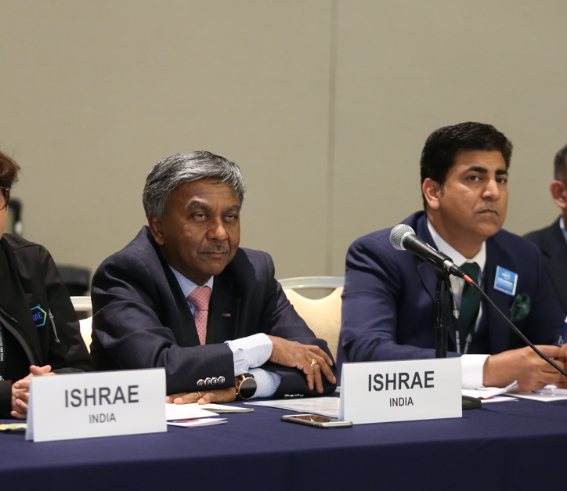
Panels or Forums
Contractor
Engineer
Architect
Owner
Code Official
Developer
Be sure to have a strong moderator to facilitate your panel
Notes:
Example of Panel Discussion members; I suggest limiting to about 4 people. If promoted properly, these can quadruple attendance.
Panel forums must have a strong moderator to keep the discussion on task.

Slide 5
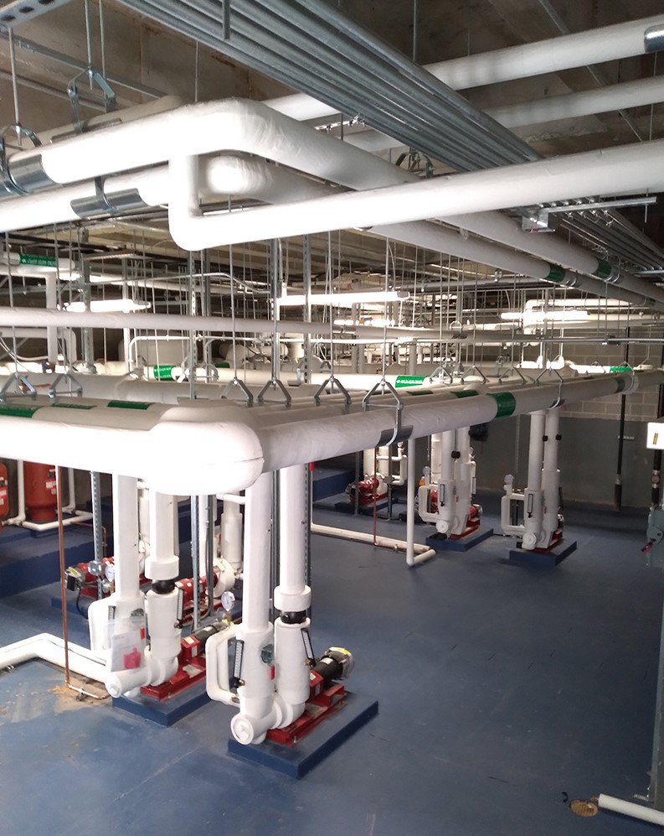
Technical Tours or Field Trips
University research labs
Industrial food or beverage processing plant
Application installations
Laboratories
Plant tour
Breweries
Clean rooms
Low temperature manufacturing facility
Cold storage warehouse
Modern supermarket
Notes:
Examples of field trips. Let others tell their success stories.

Slide 6
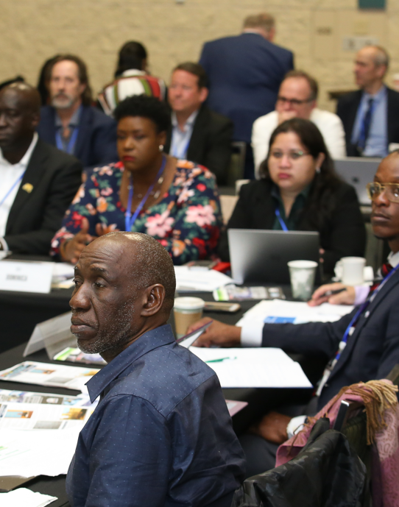
Technical or Research Talks
Host a Technical Committee Night and invite a local TC member to present
ASHRAE Research (Research Administration Committee)
  University research
  Trade association research
  Private research
Notes:
Examples of research talks. Having a research firm or University research team report on the results of an ASHRAE research project can be quite informing. Research by others on items of interest to ASHRAE works as well. Do not let a Research Promotion Chair just present a long list of ASHRAE project topics for a program or use the entire meeting to solicit donations.

Slide 7
Student, YEA or Membership Events
Meeting or technical program targeted to the interests of students or young members
Student or YEA breakfast, luncheon, night, sports day or picnic
Career mentoring by senior chapter members
Professional development seminars
Member of MP Committee and YEA Committee to sit on CTT Committee
P.E. study group

Slide 8
Chapter Seminars or Shows
Seminars
One or two per year
Valuable in promoting ASHRAE
Co-sponsored conferences
Mini Trade Shows
Chapter Sponsored Equipment Expositions
Tend to be Good for Chapter Membership and Bank Account
Some Restrictions Apply
Consult Manual of Chapter Operations for Guidelines
Product Shows
Maximum of Three Displays (4 x 8 table)
No Restrictions on Number of Products
Cannot Interfere with Chapter Meeting
No Discussion of Product during Program
Disclaimer Posted in Display Area and Listed in Published Announcements
Consult Manual of Chapter Operations for Guidelines

Slide 9
Non-Technical Talks
Diversity, Equity, and Inclusion (DEI)
Leadership skills
Legal issues (owner, architect, engineer, contractor, manufacturer, sales agent)
  Check with local Bar Association/Professional Liability Insurance firms for speakers
Research and Membership Promotion nights
Building manager/owner problems
Business management, developing economies, legal education
Notes:
Examples of non-technical programs. For Research Promotion nights I suggest you have your RP Chair highlight a few funded Research project descriptions (just a few or it will get boring) and to make a ceremony out of recognizing your honor roll and higher RP contributors, especially the major contributors.
Sometimes local facilities personnel can provide their perspective on dealing with construction issues, engineers, architects and contractors.
An occasional meeting to help teach people skills or other managerial/leadership skills is a good change of pace. Carefully select speakers for these topics.

Slide 10
Joint Meetings
Other nearby Chapters
Other societies
  Engineering
  Technical
  Architects
  Construction
  Contracting
  Trade
  CSMPS/SMPS
Notes:
Your imagination can go to work here. Think of a joint engineer and Architectural Society meeting, other Engineering Societies, Contractor Organizations, Building Owners, etc. Again, without good promotion, none of these will be successful.

Slide 11
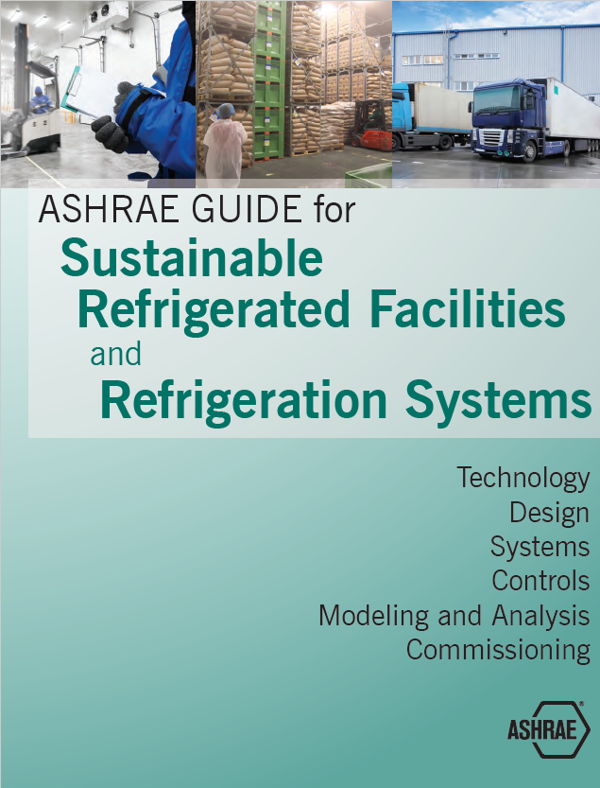
Don’t Forget the “R” in ASHRAE
Refrigeration
Plan technical tours of ice rinks, breweries, food processing plants
Use Technical Committees (TC 10 – Refrigeration Systems) for programs topics and news
Partner with other organizations related to refrigeration
Visit the Refrigeration page for more information

Slide 12

ASHRAE Learning Institute (ALI)
Chapter Professional Development
Instructor-led seminars
Self-paced courses
Developed and presented by subject matter experts at discounted rates to Chapters
Each seminar uses ASHRAE peer-reviewed materials that provide practical information that can be put to immediate practice
Visit www.ashrae.org/education for more information
Notes:
These are resources to supplement the normal Chapter meeting programs and do provide a value to ASHRAE members.

Slide 13

Tech Hour
ASHRAE Tech Hour replaced the previous annual web broadcast
Tech Hour videos are one-hour in length and worth 1 PDH
2-4 Tech Hours are published each year
Visit www.ashrae.org/techhour for more information

